Slide 1
Lab5 5-stage Pipeline Processor

Slide 2
If you have any problems about the specification,
Please contact TA as soon as possible
Contact:
何承澤 djjjimmyyy@gmail.com
Notes:
https://docs.google.com/spreadsheets/d/1ZUCVMoT-TsYwq-XjuQmA8R_mjxXebLykivcohCnJsTE/edit?usp=sharing

Slide 3
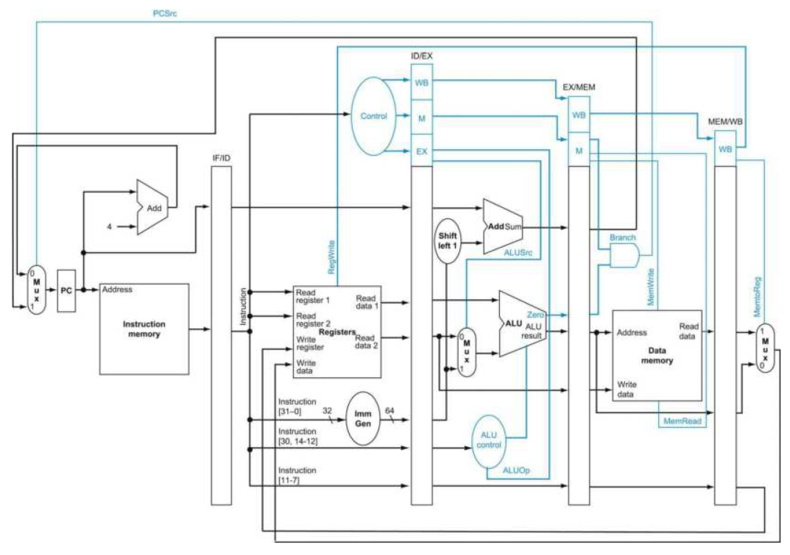
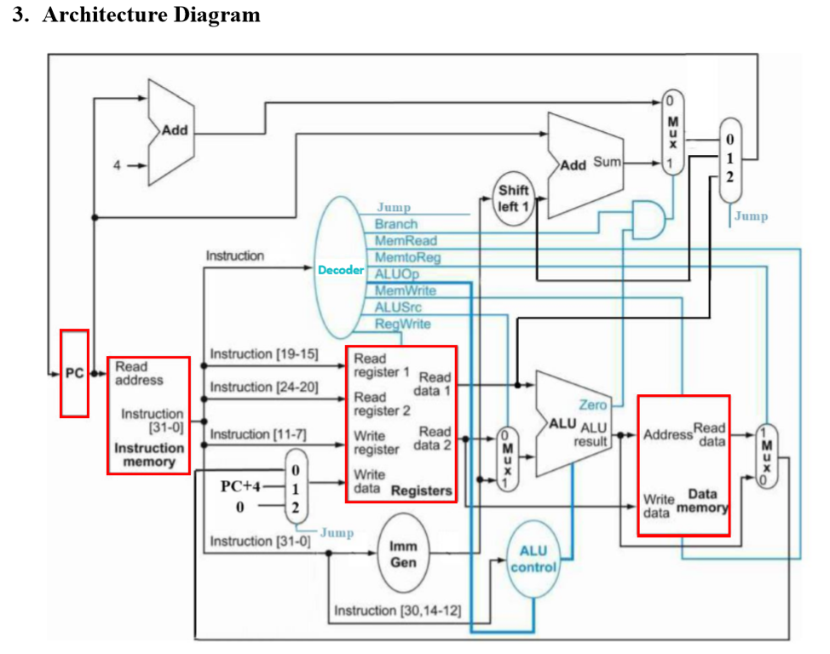
Architecture Diagram for Lab 5
Please modify your Single Cycle CPU design from Lab4 and implement a 5-stage Pipeline Processor.
Clock Positive edge triggered:
always@(posedge clk_i) begin
.
. // Code HERE
.
end
IF
ID
EX
MEM
WB

Slide 4
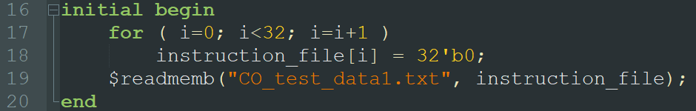
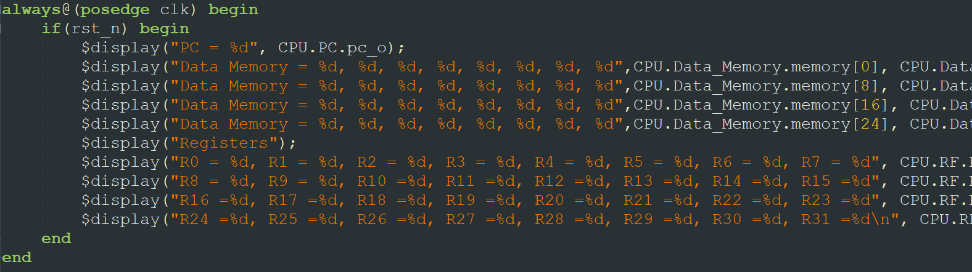
Testbench
13 test cases (CO_test_data1.txt ~ CO_test_data3.txt.)
Need to manual change by yourself
Edit line 19 in the file “Instr_Memory.v”
Notes:
目前作業有什麼問題？

Slide 5
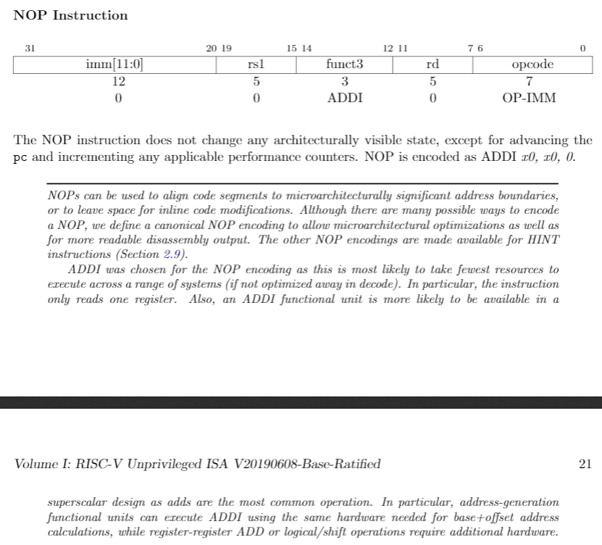
Nop instruction
Used in Stall

Slide 6
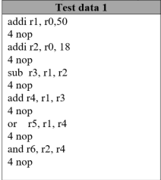
Test data 1
IF
ID
EXE
MEM
WB
IF
ID
EXE
MEM
WB

Slide 7
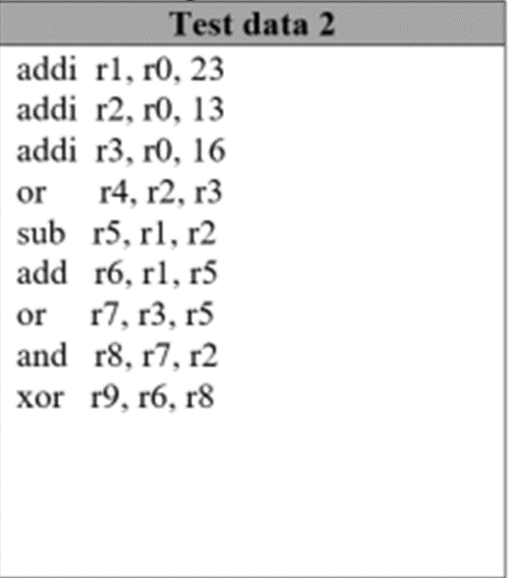

Test data 2
IF
ID
EXE
MEM
WB
IF
ID
EXE
MEM
WB
IF
ID
EXE
MEM
WB
IF
ID
EXE
MEM
WB
IF
ID
EXE
MEM
WB

Slide 8
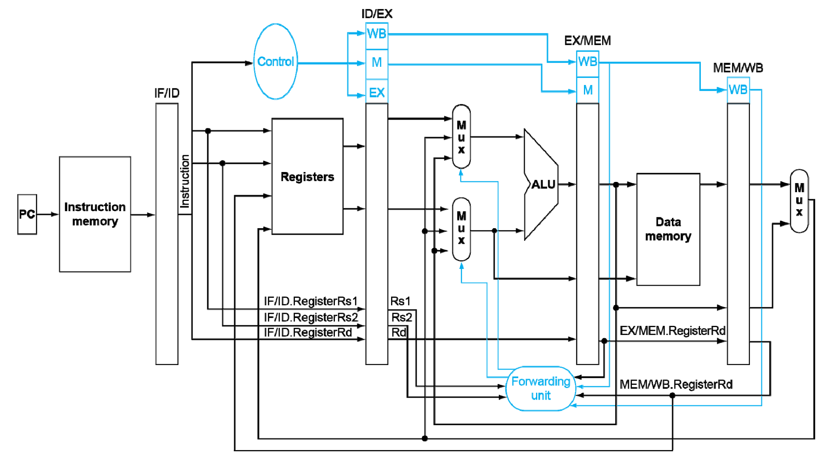
Data Dependecy
Need a ForwardingUnit.v to handle data forwarding:

Slide 9
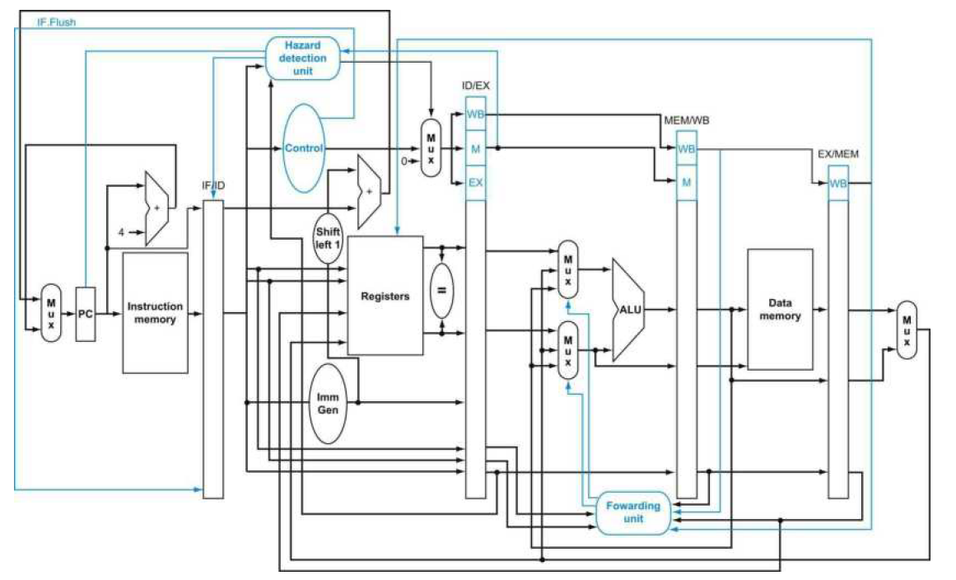
Final Datapath (forwarding, flush, hazard detection)

